Slide 1
Image processing Applications
blurring
edge detection

Slide 2
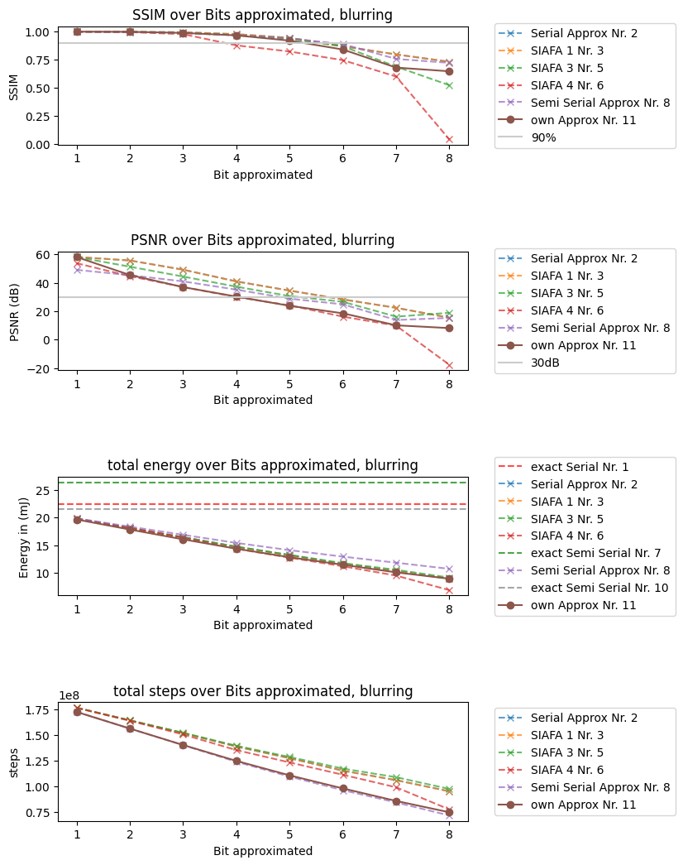
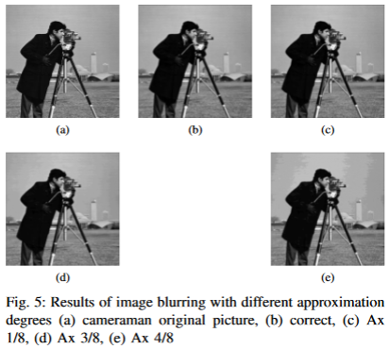

Blurring
Gaussian blurring kernel without * 1/16

Slide 3
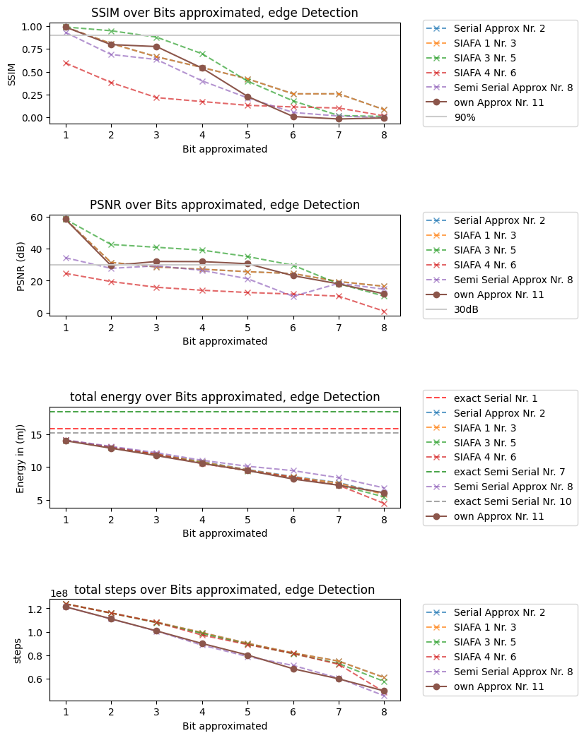
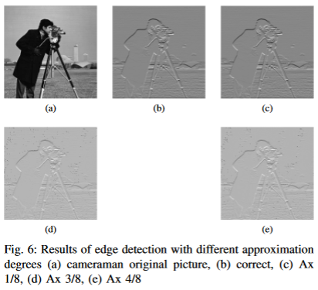

Edge detection
Sobel x kernel

